Slide 1
Microsoft Dynamics CRM
Abdul Rasheed Feroz Khan
Director – CodeSizzler
Microsoft Most Valuable Professional - Azure
https://github.com/codesizzler

Slide 2

Abdul Rasheed Feroz Khan
Founder & Director – CodeSizzler
Microsoft MVP – Azure
C# Corner MVP
@TechFero | @CodeSizzler
www.codesizzler.com
www.bit.do/ferozmvp

Slide 3
CRM
CRM Online | CRM On-Premise
Cloud based solution provided by Microsoft | On-premise solution provided by Microsoft
Pay as you go and start within a few days | Takes a long time for setting up
Less customization & extensions support | More customization & extensions support
No manual backup of data are supported | Complete availability for backup
Different storage plans | Pay more for the service
Supports for automatic updates | Need to be installed by admin

Slide 4
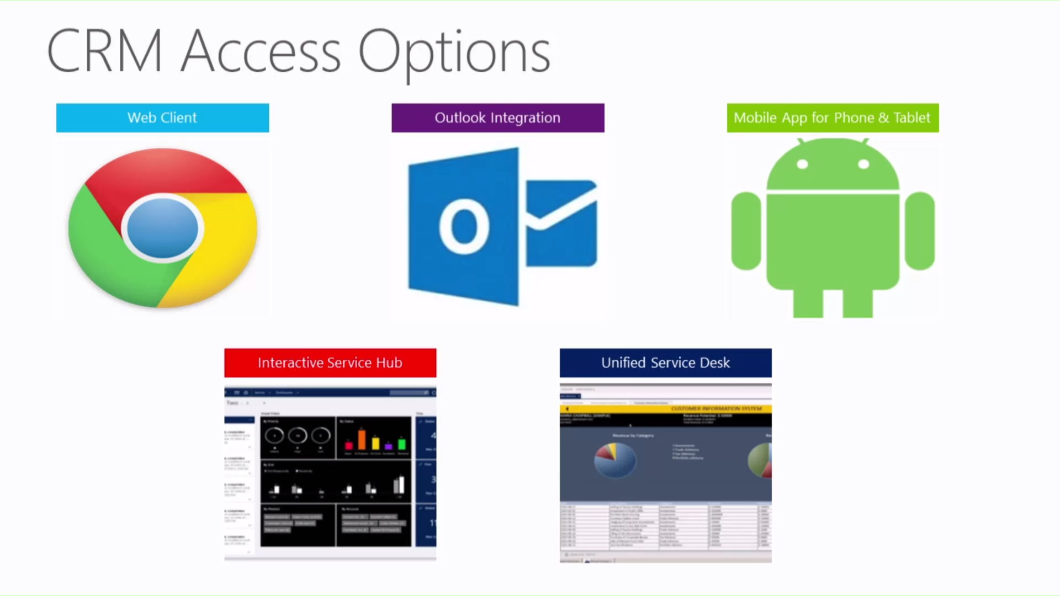
Dynamics CRM

Slide 5




Product Competitors

Slide 6
Product Versions of CRM
Microsoft CRM 1.0
Microsoft CRM 1.2
Microsoft Dynamics CRM 3.0
Microsoft Dynamics CRM 4.0
Microsoft Dynamics CRM 2011
Microsoft Dynamics CRM 2013
Microsoft Dynamics CRM 2015
Microsoft Dynamics CRM 2016

Slide 7
Trial for Dynamics CRM
https://trials.dynamics.com/Dynamics365/Signup/sales

Slide 8
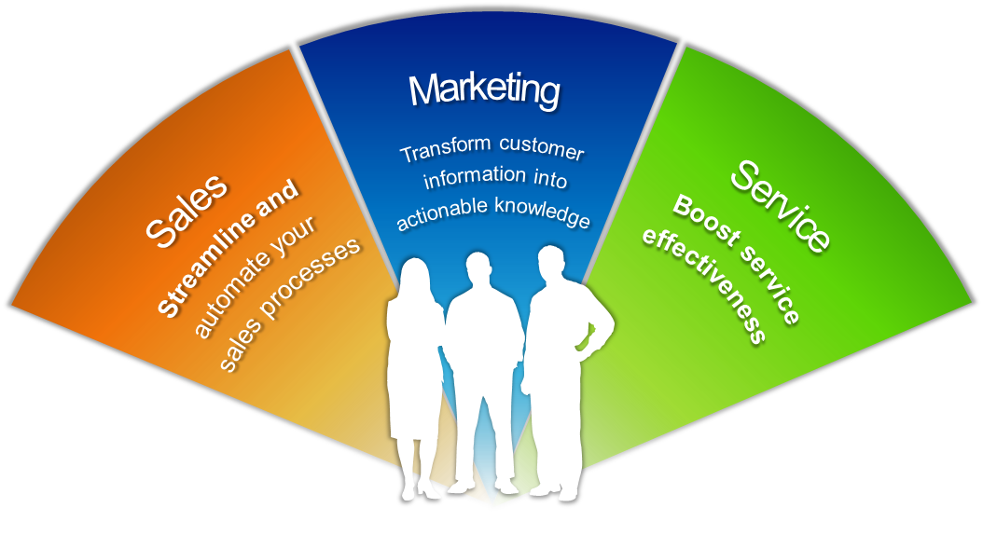
Functions of Dynamics CRM

Slide 9
Demo – Activating your Dynamics CRM free trial account

Slide 10
Video link - https://youtu.be/mRm_Nb9wROU

Slide 11

Thanks for joining
codesizzler@outlook.com
Twitter - @CodeSizzler

